Slide 1




Hybrid data structure
DSA DYNAMOS
Roll Number | Name
CB.EN.U4CSE21415 | SAMRAT
CB.EN.U4CSE21420 | ROHAN LAL
CB.EN.U4CSE21428 | AMMI REDDY
CB.EN.U4CSE21451 | HARINADHA RAJU
CB.EN.U4CSE21467 | VINAYAKAN

Slide 2
WHY?
Enhanced Performance
Tailored Functionality
Flexibility and Adaptability

Slide 3
HYBRID PRIORITY QUEUE
HYBRID PRIORITY QUEUE
MIN-HEAP
HASH-MAP
+

Slide 4
OVERVIEW
Min-Heap: Parent node has a lower value than its child nodes, In the context of a priority queue, the min-heap ensures that the element with the highest priority (lowest value) is always at the root,
Hash Map: It provides efficient key-value pair lookups, insertions, and deletions. In the context of a hybrid priority queue, the hash map is used to associate elements with their unique identifiers, enabling fast access, update, and removal based on identifiers.

Slide 5
ADVANTAGES
Efficient Priority-Based Operations
Fast Lookup and Update by Identifier
Flexibility and Versatility
Scalability

Slide 6
Implementation Details
Insert
Delete
Search

Slide 7
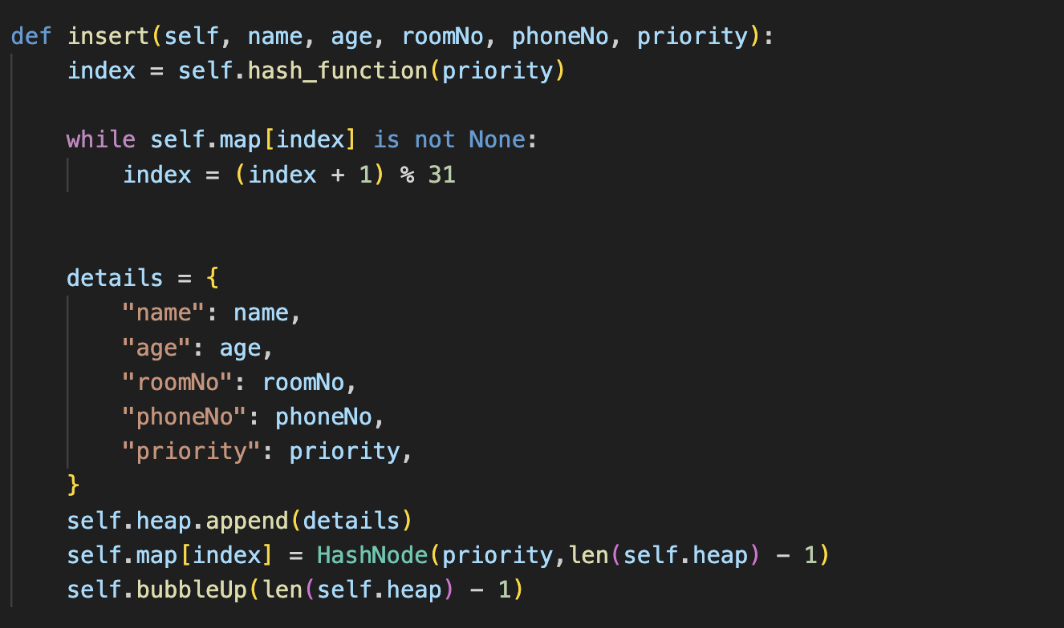
Insert Operation
z

Slide 8
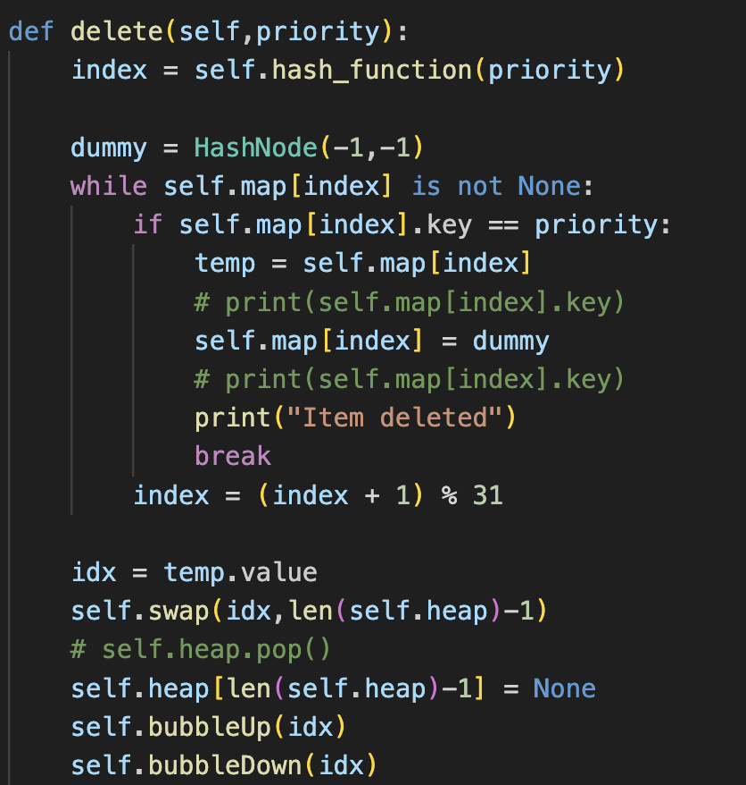
Delete Operation
z

Slide 9

Search Operation
z

Slide 10
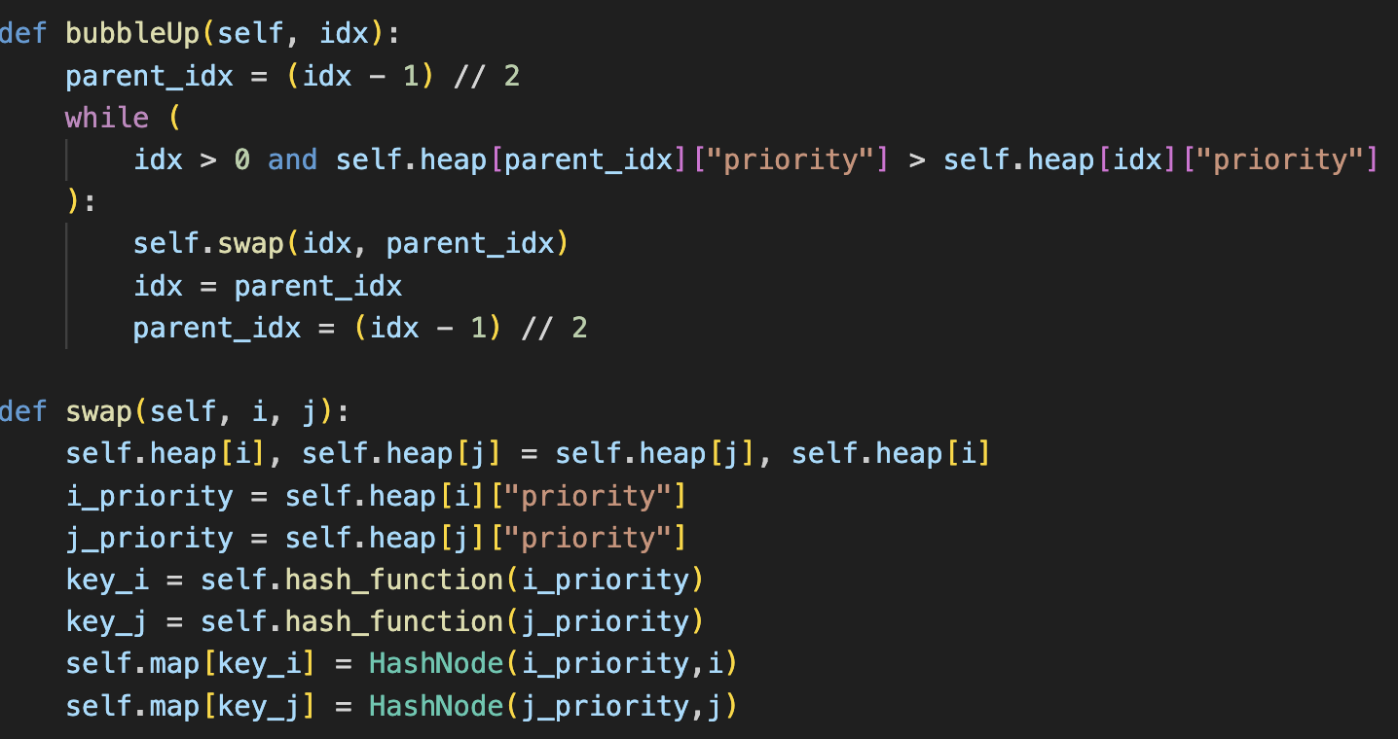
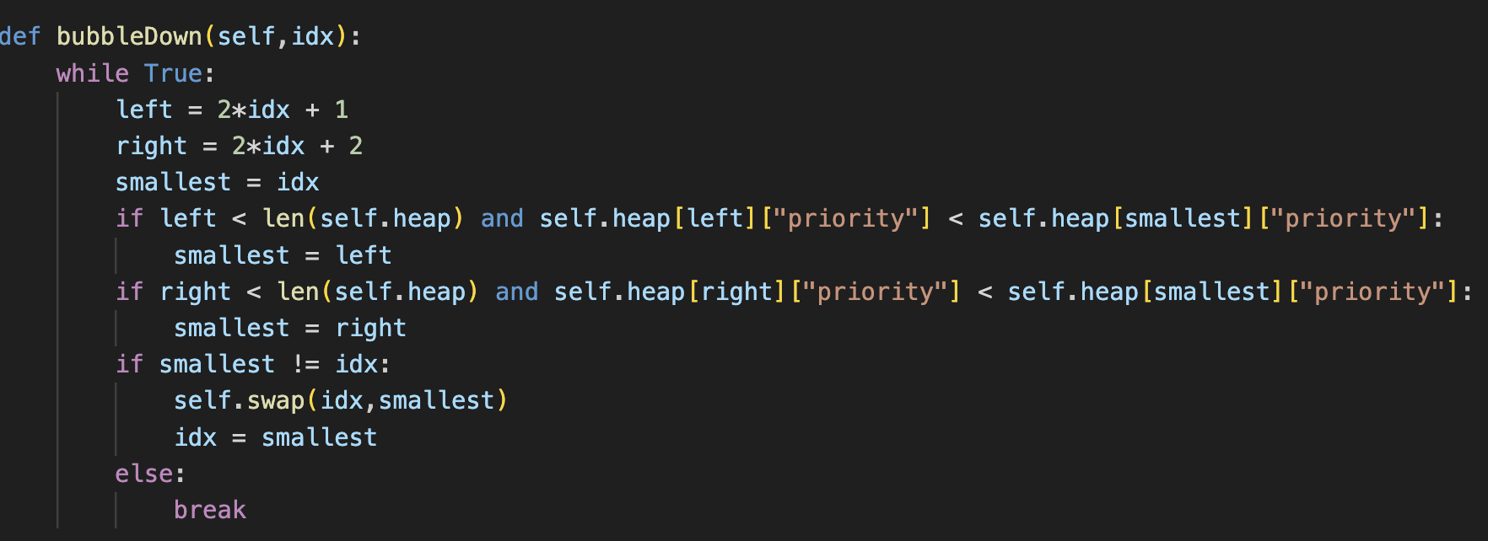
Heapification
z

Slide 11
1
2
3
4
5
1
ArrayIndexes
Insert(1)
Hash Values
Insert(2)
Insert(3)
1
0
2
3
Insert(4)
Insert(5)
2
1
Delete(5)
4
5
Delete(4)
3
2
Delete(3)
Delete(2)
Delete(1)
4
3
Insertion
5
4
Deletion

Slide 12

REAL LIFE USE CASE : HOSPITAL MANAGEMENT SYSTEM
z

Slide 13

This is a Scenario of a Hospital Management system where this Hybrid data structure is used for assigning priorities to the patients based on their respective health problems. The priorities are assigned by the receptionist based on how fast the treatment is required to the patient. The patients goes to the doctor one by one based on the priority/order mentioned by the receptionist. The system takes the information of patients which are given by receptionist. The information contains Priority, Name, Phone Number, Room Number and some more information about the disease. The patients after getting treated by doctor are removed and the system gets updated every-time the patients leave the hospital so that we get to know which patient to be sent next.
For suppose there are some visitors to the hospital to see how the patient is they need to get to know information about patient where the respective patient room has been allotted. In this case there need to be efficient search operation to get to know details of patient here we use a specific data structure where search is faster than any other.

Slide 14
PERFORMANCE ANALYSIS
FUNCTION | TIME COMPLEXITY
INSERTION | O(logn)
DELETION | O(logn)
SEARCH | O(1)

Slide 15
Experimental Evaluation:
FUNCTION | EXECUTION TIME
INSERTION | 0.042431687
DELETION | 0.00106405
SEARCH | 0.015568698

Slide 16
CONCLUSION
1.Practical Applications: The hybrid priority queue has practical applications in scenarios where elements need to be prioritized based on their priorities and retrieved or updated efficiently using their names. Examples include task scheduling, job prioritization, event handling, and resource allocation, hospital management, Online ticketing.
2.Performance Analysis: The hybrid data structure offers efficient performance in terms of insertion, deletion, and retrieval operations. Insertion and deletion have a time complexity of O(log n), where n is the number of elements. Retrieving an element by name or obtaining the maximum priority element takes constant time, making the data structure suitable for real-time or time-critical applications.
3.Efficiency: The hybrid data structure optimizes space utilization by storing the element details in a hash map, avoiding duplication in the min heap. This results in efficient memory usage, particularly when dealing with large datasets or when memory resources are limited.
4.Overall Success: The project can be considered successful as it achieved its objectives of implementing a hybrid priority queue using a min heap and a hash map. The data structure provides a flexible and efficient solution for managing prioritized elements and enables fast retrieval and update operations based on element names.

Slide 17

THANK YOU From DSA DYNAMOS
z

